Slide 1
Animal Classification Using Ensemble CNN Model

Slide 2
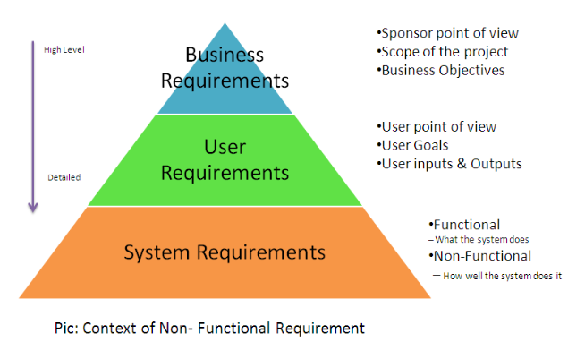
Functional Requirement

Slide 3
Statements of services that the system should provide, how the system should react to particular inputs and how the system should behave in particular situations.
Describe functionality or system services.
Depend on the type of software, expected users and the type of system where the software is used Functional user requirements may be high-level statements of what the system should do; functional system requirements should describe the system services in details.
Data set of 12 type of animal images with pixel value as features and folder names as labels.

Slide 4
Pre-processing is a procedure adopted to enhance the quality of images and increase visualization. In animal imaging, image processing is a crucial phase that helps to improve the images quality. This can be one of the most critical factors in achieving good results and accuracy in next phases of proposed methodology. wound images may contain a different issue that may lead to poor and low visualization of the image. If the images are poor or of low quality, it may lead to unsatisfactory results. During preprocessing phase, we performed background elimination, elimination of non-essential blood supplies, image enhancement, and noise removal.
Features are selected to apply Multiple CNN algorithms and Ensemble resent, . The classification algorithm is being discussed further. Attributes are selected as features if they are not dependent on other attributes and they increase efficiency of the classification. After selection of attributes, the dataset of animals that are already classified is saved as model and test set is used for accuracy confusion matrix.

Slide 5
Classification is the process of categorizing a data object into categories called classes based upon features/attributes associated with that data object. Classification uses a classifier, an algorithm that processes the attributes of each data object and outputs a class based upon this information
Confusion Matrix is a technique for describing the performance of a classification algorithm. Confusion Matrix is used to give you a better idea of what your classification model is getting right and what types of errors it is making.

Slide 6
Non Functional Requirement
Constraints on the services or functions offered by the system such as timing constraints, constraints on the development process, standards, etc.
Availability: A system's availability, or "uptime," is the amount of time that it is operational and available for use. This is specified because some systems are designed with expected downtime for activities like database upgrades and backups.
Efficiency: Specifies how well the software utilizes scarce resources: CPU cycles, disk space, memory, bandwidth, etc.

Slide 7
Flexibility: If the organization intends to increase or extend the functionality of the software after it is deployed, that should be planned from the beginning; it influences choices made during the design, development, testing, and deployment of the system.
Portability: Portability specifies the ease with which the software can be installed on all necessary platforms, and the platforms on which it is expected to run.
Integrity: Integrity requirements define the security attributes of the system, restricting access to features or data to certain users and protecting the privacy of data entered into the software.
Performance: The performance constraints specify the timing characteristics of the software. Certain tasks or features are more time-sensitive than others; the nonfunctional requirements should identify those software functions that have constraints on their performance.

Slide 8
Reliability: Reliability specifies the capability of the software to maintain its performance over time. Unreliable software fails frequently, and certain tasks are more sensitive to failure (for example, because they cannot be restarted, or because they must be run at a certain time).
Reusability: Many systems are developed with the ability to leverage common components across multiple products. Reusability indicates the extent to which software components should be designed in such a way that they can be used in applications other than the ones for which they were initially developed.
Robustness: A robust system is able to handle error conditions gracefully, without failure. This includes a tolerance of invalid data, software defects, and unexpected operating conditions.
Scalability: Software that is scalable has the ability to handle a wide variety of system configuration sizes. The nonfunctional requirements should specify the ways in which the system may be expected to scale up (by increasing hardware capacity, adding machines, etc.).
Usability: Ease-of-use requirements address the factors that constitute the capacity of the software to be understood, learned, and used by its intended users.

Slide 9
LITERATURE SURVEY
S.No | Author | Title | Description
1 | Dhruv Rathi, Sushant Jain, Dr. S. Indu, | Underwater Fish Species Classification using Convolutional Neural Network and Deep Learning” | . The accompanying advance uses Deep Learning approach by execution of Convolutional Neural Network for fish species characterization. Correlation of ReLU, Soft Max and tanh initiation capacities was performed and ReLU initiation work was viewed as profoundly precise
2 | Mohamad Aqib Haqmi Abas, Nurlaila Ismail, | VGG16 for plant image classification with transfer learning and data augmentation | Vgg 19 model is used for training plant images classification
3 | Hanguen Kim, Jungmo Koo, Donghoonkim | Image-Based Monitoring of Jellyfish Using Deep Learning Architecture | This letter presents preliminary results of applying an image-based jellyfish distribution recognition algorithm to increase the efficiency of an existing jellyfish removal system. By using a convolutional neural network and dedicated image processing techniques, the experimental results show reasonable performance for real-world application.

Slide 10
LITERATURE SURVEY
S.No | Author | Title | Description
4 | H. Yousif, J. Yuan, R. Kays | Fast human-animal detection from highly cluttered camera-trap images using joint background modeling and deep learning classification | This paper develops an effective background modeling and subtraction scheme to generate region proposals for the foreground objects and performs complexity-accuracy analysis of deep convolutional neural networks to develop a fast deep learning classification scheme
5 | Sayagavi, A.V., Sudarshan, T.S.B., Ravoor, | Deep Learning Methods for Animal Recognition and Tracking to Detect Intrusions. | The intrusion detection pipeline consists of three stages—animal detection, animal tracking and user alerts, and notifications. The proposed system is cost-effective and highly efficient, with an average accuracy of 98.8% in detecting and identifying animals in images.
6 | H. Nguyen et al | Animal Recognition and Identification with Deep Convolutional Neural Networks for Automated Wildlife Monitoring, | Deep learning algorithms are used for training and predicting animal images

Slide 11
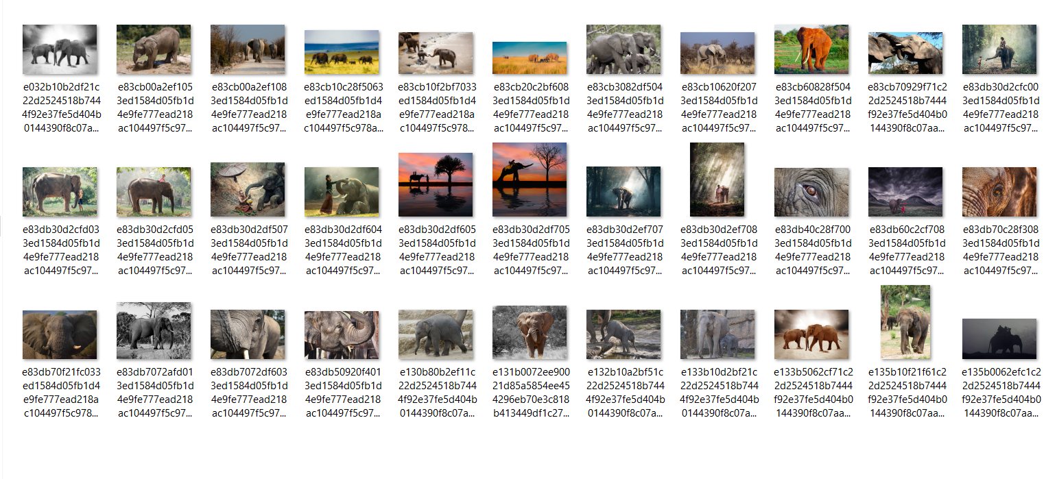
Data Collection

Slide 12
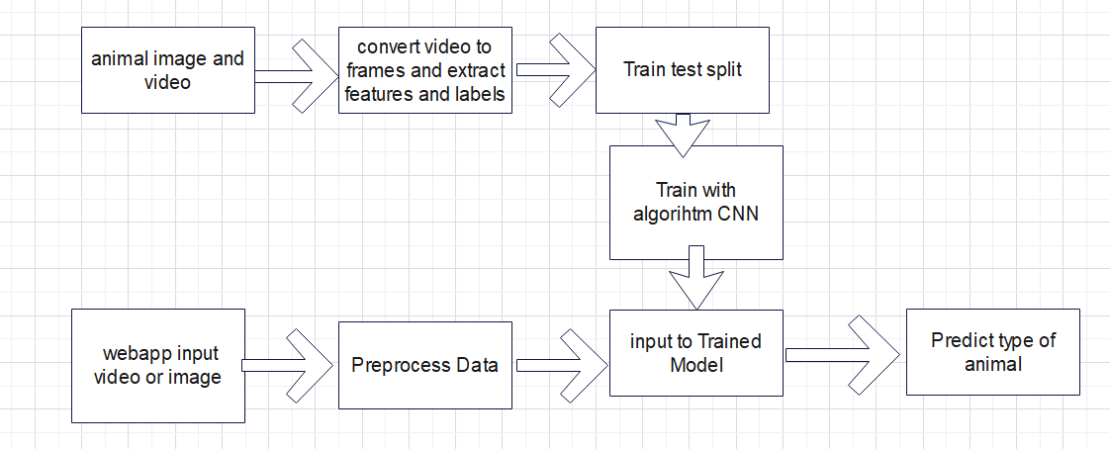
Architecture Diagram

Slide 13
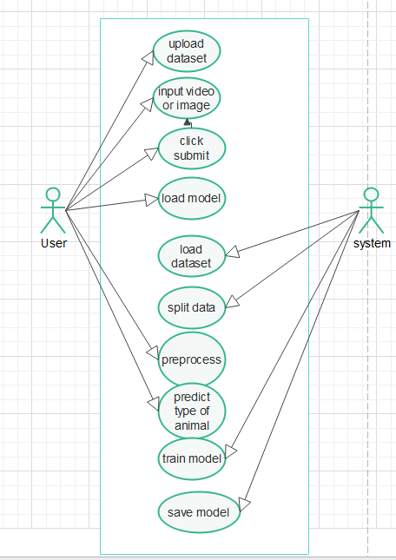
Use case Diagram

Slide 14
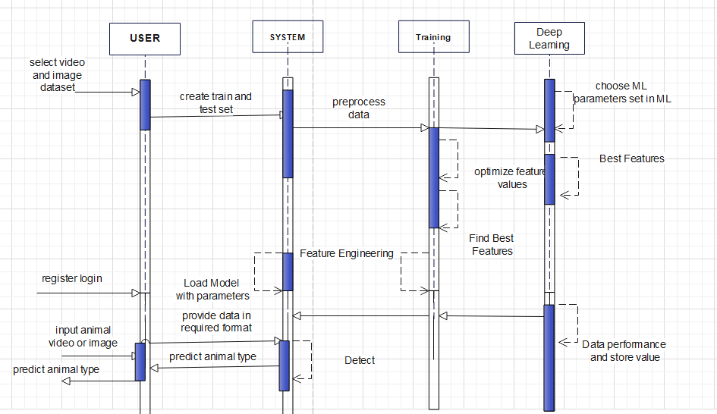
Sequence Diagram

Slide 15
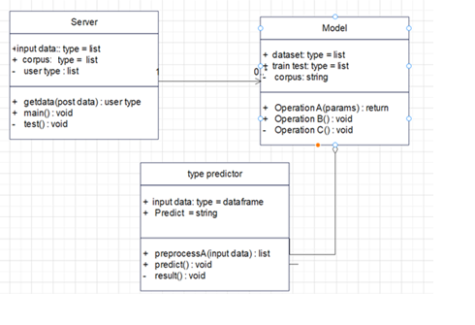
Class Diagram

Slide 16
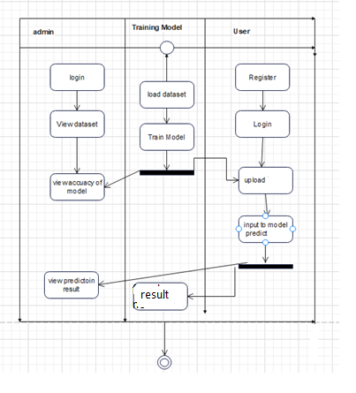
Activity Diagram

Slide 17
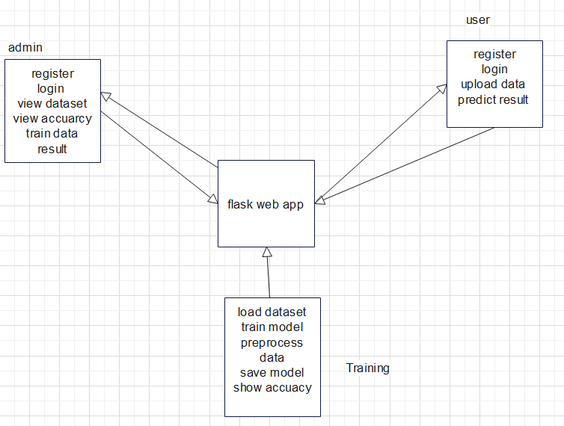
Data Flow Diagram

Slide 18
Existing System
In existing system they proposed a machine learning methods are used for animal detection like SVM.
In other works they used a network of cameras, connected to PIR motion sensors, so that image capture is triggered only when some movement is detected. The images captured through these cameras are processed to detect the presence of wild animals using YOLO, and if an animal is found, identify the species. Once identified, the animals are tracked for a suitable time using CSRT in order to determine their intent – such as to find whether they are moving across the village, or into it. In the latter case, alerts are generated and local authorities are notified through proper channels. The models at present can detect 5 types of animals namely (elephant, zebra, giraffe, lion and cheetah).

Slide 19
Proposed System
Here, we present a system 12 animal pictures dataset is used. the proposed plan of model for animal Image Order utilizing hybride Convolutional Neural Network. The Aminal-12 dataset utilized for the grouping is taken from Kaggle. We are utilizing Convolutional Neural Network with ensemble model by combining three DL CNN models (Resent, inceptionv3 and efficient net). Utilization of Image Processing along with Loading, Testing, Training, and Validating the dataset before the preparation step makes a difference to eliminate the noise, obstructions, smoothness and dust from the pictures.
In next step we develop a web app using flask framework with mysql database to show prediction of result with graphical representation.

Slide 20
Basic Concepts and Terminology
Machine learning
Deep learning
Ensemble model
Classification
Security alert system

Slide 21
Problem Statement
The expansion of urban areas in modern times has resulted in widespread displacement of habitats in forested areas. As a result, wild animals are forced to venture into the human settlements that often infringe on their routine activities. More often than not, food is the primary motivator for such peregrinations. It is at this point that there is tangible danger to any humans that inadvertently cross the path of these animals when they are at their most ferocious predispositions. Hence, a need arises for the detection of wild animals at the border of human settlements close to wild habitats.

Slide 22
Hardware requirements
System : Pentium IV 2.4 GHz.
Hard Disk : 100 GB.
Monitor : 15 VGA Color.
Mouse : Logitech.
RAM : 1 GB.

Slide 23
Software requirements
Operating system : Windows XP/7/10
Development framework : flask framework
Programming language : Python
Dataset : animal dataset
IDE : Anaconda prompt

Slide 24
modules
Data COLLECTION:
IN this project we use wound dataset collected from Kaggle which has 12 categories of animals . Pixel values form images are taken as input and labels are used as output and each folder has 50 images which are used for training. Video dataset of animals is also taken to train for prediction from videos.
Pre-processing:
Pre-processing is a procedure adopted to enhance the quality of images and increase visualization. In animal imaging, image processing is a crucial phase that helps to improve the images quality. This can be one of the most critical factors in achieving good results and accuracy in next phases of proposed methodology. wound images may contain a different issue that may lead to poor and low visualization of the image. If the images are poor or of low quality, it may lead to unsatisfactory results. During preprocessing phase, we performed background elimination, elimination of non-essential blood supplies, image enhancement, and noise removal.

Slide 25
Train-Test Split and Model FITTING:
Now, we divide our dataset into training and testing data. Our objective for doing this split is to assess the performance of our model on unseen data and to determine how well our model has generalized on training data. This is followed by a model fitting which is an essential step in the model building process.
Model Evaluation and Predictions:
This is the final step, in which we assess how well our model has performed on testing data using certain scoring metrics, I have used 'accuracy score' to evaluate my model. First, we create a model instance, this is followed by fitting the training data on the model using a fit method and then we will use the predict method to make predictions on x_test or the testing data, these predictions will be stored in a variable called y_test_hat. For model evaluation, we will feed the y_test and y_test_hat into the accuracy_score function and store it in a variable called test_accuracy, a variable that will hold the testing accuracy of our model. We followed these steps for a variety of classification algorithm models and obtained corresponding test accuracy scores.

Slide 26
Flask Webpp:
In this step web app is developed for showing predictions which is developed using flask. User uploads image and video of animals and get prediction results as output with animal name.

